Slide 1

Introduction to Azure Durable Functions

Slide 2
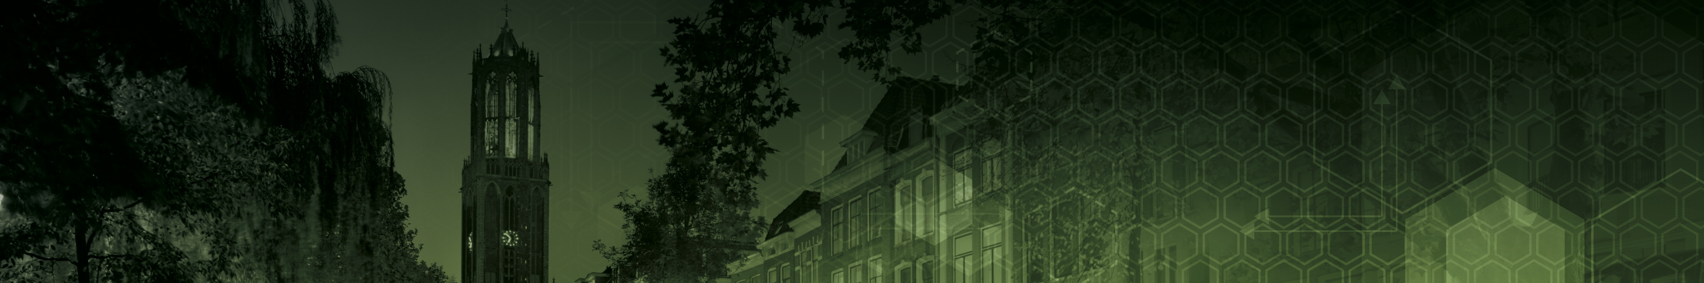



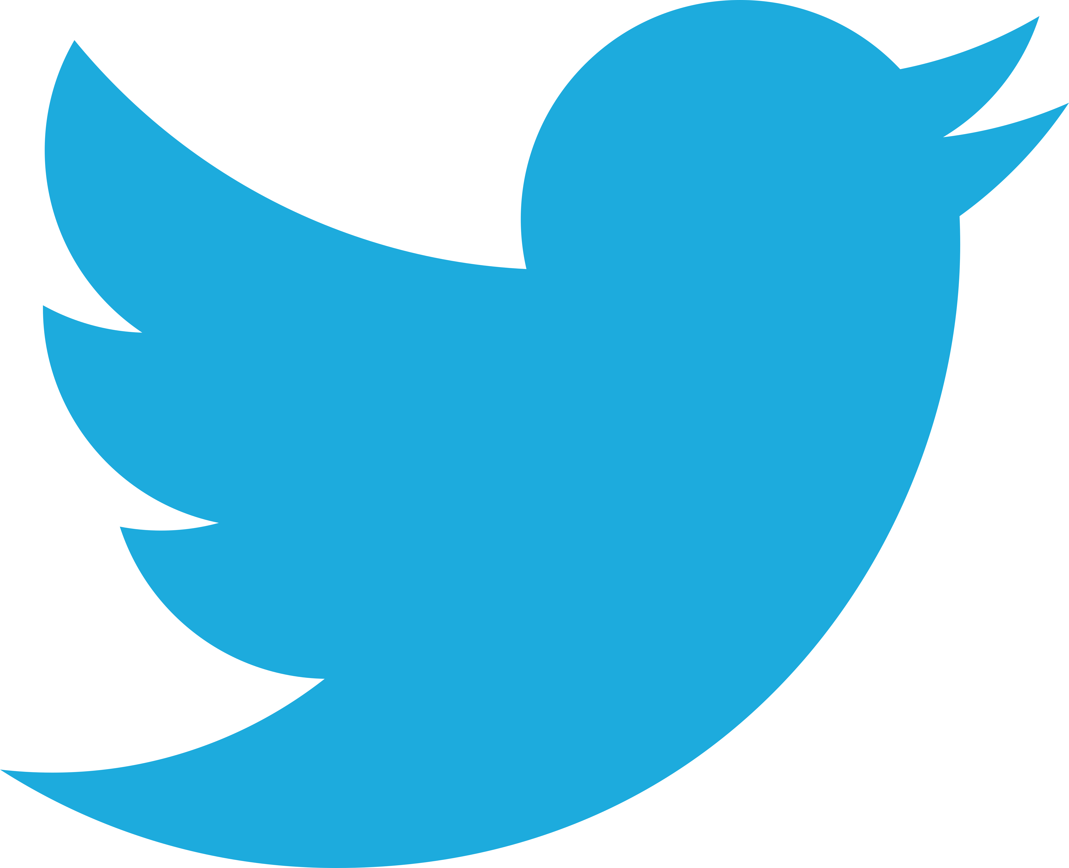
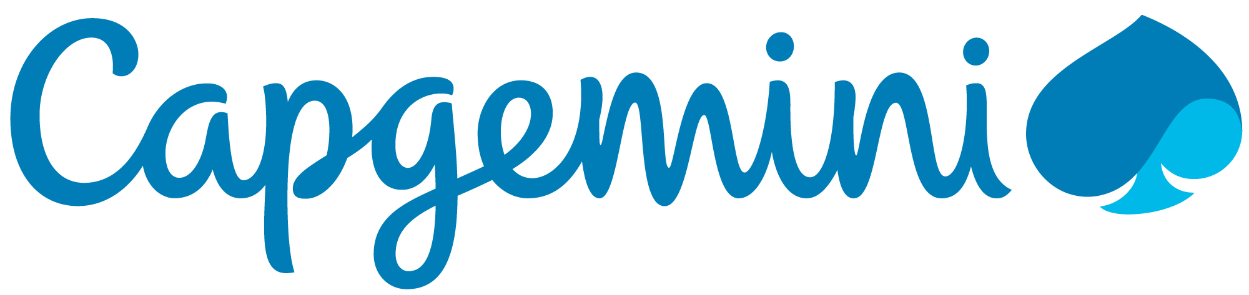
About me
Carl in ’t Veld
Full stack software engineer
MCSD App Builder
@cveld
@CapgeminiNL

Slide 3
Outline
Serverless
Azure Functions
Durable Functions
Demo 1: the basics
Sequence pattern
Demo 2: Workflow
Suborchestrator and external events
Demo 3: Flights API monitoring
External API monitoring
Demo 4: Fractal processing
Fan-out / Fan-in pattern

Slide 4


What is serverless?
Full abstraction of servers
Developers can just focus on their code—there are no distractions around server management, capacity planning, or availability.
Instant, event-driven scalability
Application components react to events and triggers in near real-time with virtually unlimited scalability; compute resources are used as needed.
Pay-per-use
Only pay for what you use: billing is typically calculated on the number of function calls, code execution time, and memory used.*
*Supporting services, like storage and networking, may be charged separately.
Notes:
Slide taken from .NET Conf 2018

Slide 5
FaaS is at the center of serverless Functions-as-a-Service programming model use functions to achieve true serverless compute
Single responsibility
Functions are single-purposed, reusable pieces of code that process an input and return a result
Short lived
Functions don’t stick around when finished executing, freeing up resources for further executions
Stateless
Functions don’t hold any persistent state and don’t rely on the state of any other processes
Event driven & scalable
Functions respond to predefined events, and are instantly replicated as many times as needed
Future Tech – 13 March 2019 – Introduction to Azure Durable Functions – Carl in ’t Veld – @cveld
Notes:
Slide taken from .NET Conf 2018

Slide 6
The evolution of application platforms
On-Premises
IaaS
PaaS
Serverless
Notes:
Slide taken from https://channel9.msdn.com/Events/Build/2018/BRK2132

Slide 7
What is serverless?
$
Abstraction of servers
Event-driven/ instant scale
Micro-billing
Notes:
Slide taken from https://channel9.msdn.com/Events/Build/2018/BRK2132

Slide 8



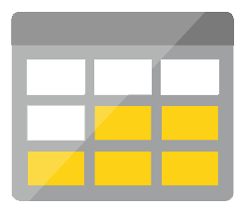




Serverless application platform components
Development
Platform
IDE support
Functions
Logic apps
Event Grid
Integrated DevOps
Developer productivity
Visual designer
Manage all events in one place
Triggers and Bindings
200+ connectors
Near real-time delivery
Local development
Flexible deployment options
Cloud / On-Premise
Functions orchestration
Broad coverage
Monitoring
Database
Storage
Security & Access Control
IoT
Analytics
Intelligence
Visual Debug History
Notes:
Slide taken from https://channel9.msdn.com/Events/Build/2018/BRK2132

Slide 9






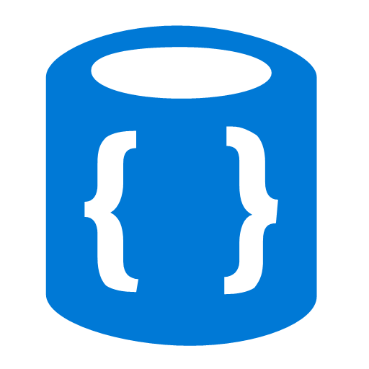


Azure Functions
Events
Code
Outputs
React to timers, HTTP, or events from your favorite Azure services, with more on the way
Author functions in C#, F#, Node.JS, Java, and more
Send results to an ever-growing collection of services
Future Tech – 13 March 2019 – Introduction to Azure Durable Functions – Carl in ’t Veld – @cveld
Notes:
Taken from Ignite 2018

Slide 10





Full integration with Azure ecosystem Functions is the center piece of the Serverless platform
Development
Platform
IDE support
Event Grid
Functions
Logic Apps
Manage all events that can trigger code or logic
Execute your code based on events you specify
Design workflows and orchestrate processes
Integrated DevOps
Local development
Monitoring
Database
Storage
Analytics
Intelligence
Security
IoT
Visual debug history
Future Tech – 13 March 2019 – Introduction to Azure Durable Functions – Carl in ’t Veld – @cveld

Slide 11
Bindings and integrations
Microsoft.NET.Sdk.Functions (.NET Standard 2.0) HTTP and Timer
Microsoft.Azure.WebJobs.Extensions.Storage
Microsoft.Azure.WebJobs.Extensions.ServiceBus
Microsoft.Azure.Webjobs.Extensions.EventHubs
Microsoft.Azure.WebJobs.Extensions.CosmosDB
Microsoft.Azure.Webjobs.Extensions.EventGrid
Microsoft.Azure.Webjobs.Extensions.MicrosoftGraph 1.0.0-beta6
Microsoft.Azure.WebJobs.Extensions.DurableTask GA July 2018
Microsoft.Azure.Webjobs.Extensions.SignalRService 1.0.0 since last week! Azure SignalR Service GA September 2018
All open source
Future Tech – 13 March 2019 – Introduction to Azure Durable Functions – Carl in ’t Veld – @cveld
Notes:
Taken from .NET Conf 2018

Slide 12
What if my task isn’t short lived, simple, and stateless?

Slide 13
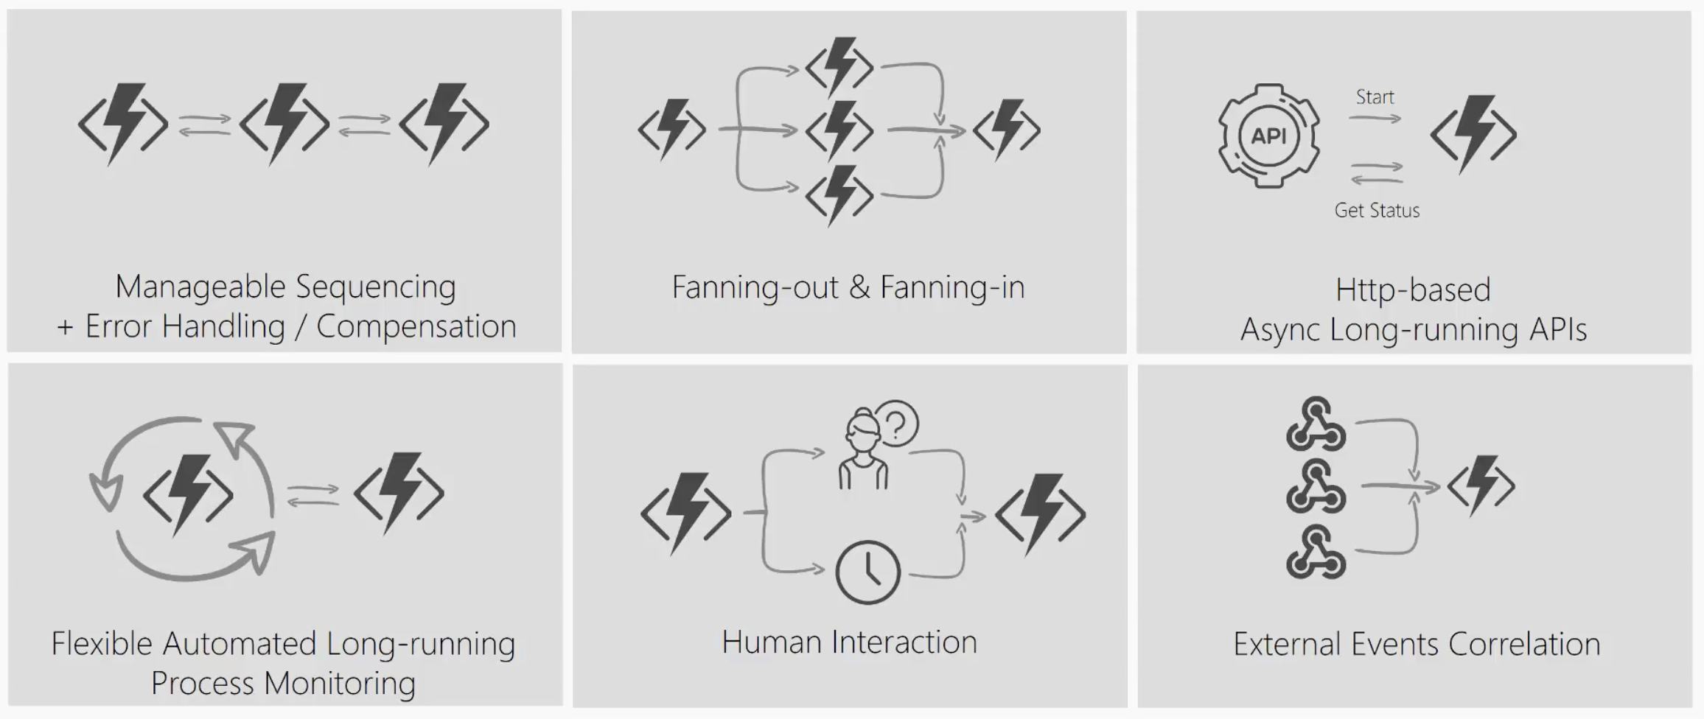
What’s still hard?
Future Tech – 13 March 2019 – Introduction to Azure Durable Functions – Carl in ’t Veld – @cveld
Notes:
Taken from .NET Conf 2018
Imagine a scenario where I have to take the output of a Function and use it as the input to call another Function. I’ll have to coordinate the chaining manually.
If I have to have a function that takes some sort of event and then parallelizes it into multiple Functions, I can still do that but how will I know when all Functions have finished executing so I can aggregate the results and move on.
What if I had to listen on multiple events and aggregate their outcome to determine which specific job or function to run in my application.
What if I wanted to do some kind of extended monitoring on an endpoint? For example, if I were to monitor the temperature of a remote machine and take action x if the temperature were lower than a certain threshold, else do y or run job y.
What if I have an API or endpoint that was running for a long time? I know Functions are short-lived but sometimes you guys put some serious load on them. Could there be a mechanism to provide status of the execution back to the client so they’re not left hanging?
And lastly, what if I wanted to get some sort of human interaction in there? For example, if I am to do some sort of 2FA in the middle of my function execution but also don’t want to wait forever because sometimes people take forever to reply especially when the texts are automated.
Today, I’m going to be talking about some of these problems – how you can approach them in regular FaaS? And how they can be simplified with the technology of Durable Functions.

Slide 14
Introducing Durable Functions
Advanced extension on top of Azure Functions leveraging the open source Durable Task Framework
Write long-running orchestrations as a single function while maintaining state reliably
Easily call a Function from another Function, synchronously or asynchronously
All of the above using code-only. No JSON schemas. No graphical designer
Support for C# and JavaScript
Notes:
Taken from .NET Conf 2018
Durable Functions is an advanced feature of Azure Functions. They provide the ability to write long running orchestrations using a single function while still being able to maintain a global state.
Durable highly simplifies some of the scenarios that we saw in the previous slides by making it easy to implement scenarios such as chaining, fan out / fan in , etc.
While still being able to use your beloved code constructs. You don’t have to conform to an JSON schemas or adopt any graphical workflow designers.
So let’s take a look at what it means to use Durable Functions ….. with some real world problems or patterns ->

Slide 15
Components
Starter
Function
Orchestrator Function
Activity Function
Activity Function
Activity Function
Starts orchestrations
Coordinates activities
Performs work
OrchestrationClient
OrchestrationContextTrigger
ActivityTrigger

Slide 16
What It Looks Like
Orchestrator Function
// calls functions in sequence
public static async Task<object> Run(DurableOrchestrationContext ctx)
{
try
{
var x = await ctx.CallActivityAsync("F1");
var y = await ctx.CallActivityAsync("F2", x);
return await ctx.CallActivityAsync("F3", y);
}
catch (Exception)
{
// global error handling/compensation goes here
}
}
Activity Functions
Notes:
> So in Durable Functions, we introduce the concept of “an orchestrator" that will orchestrate or manage what happens between rest of the Functions.
> It is responsible for calling and receiving output from activity functions that you’re familiar with as regular functions. When an activity returns, it return value becomes part of the local state of the orchestrator function so you’re able to work with it as any other variable in that block of code.
> CallFunctionAsync uses queues under the covers, thus they can be scaled out to multiple VMs.
The other thing is that if I want to have exceptions in my code, say something goes wrong in a particular function, I can do that. We’re all familiar with the syntax and now we can do it in a distributed way.
Mention rewind feature to talk about in new developments

Slide 17
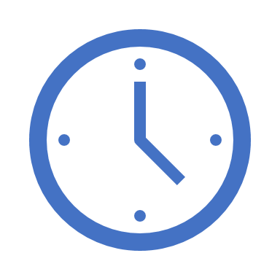

var outputs = new List<string>();
outputs.Add(await context.CallActivityAsync<string>("SayHello", “Future Tech"));
return outputs;
History Table
Orchestrator Function
Orchestrator Function
Activity Function
Orchestrator Started
Activity Function
Execution Started
Task Scheduled, SayHello, “Future Tech”
Orchestrator Completed
[“Hello Future Tech!”]
“Hello Future Tech!”
“Hello Future Tech!”
Task Completed, “Hello Future Tech!”
?
Orchestrator Started
Execution Completed, ["Hello Future Tech!"]
Orchestrator Completed
Execution History
Notes:
Grasping how orchestrators use execution history to replay and rebuild their local state is key to understanding how Durable Functions works, so let’s walk through the execution of a simple orchestrator function.
The light blue box at the top of the slide is the orchestrator’s code.
“SayHello” our activity function, which returns “Hello” and whatever input you give it.
Our execution history is currently empty. As we start to record events, they’ll show up here. (Indicate area.)
1. A request is made to the orchestrator function.
2. The orchestrator starts and begins executing until it’s asked to await some async work. In this case, we want to call an activity function.
3. The orchestrator checks the execution history for a record of the activity function.
4. There’s no record of the activity function being called or completed, so the orchestrator schedules that work.
5. While the orchestrator waits on work to complete, it shuts down.
5. The scheduled activity function runs.
6. A record of this is added to the execution history. In this case we produced output, so that’s stored.
7. Now the orchestrator has more work to do. It restarts and executes its code **from the beginning** to build up its local state.
8. As before, the orchestrator executes until it reaches an await.
9. The orchestrator checks the execution history. This time there’s a record of the async work being done.
10. The activity function’s stored output is passed back to the orchestrator. In this case, the value is added to a list of strings.
11. The orchestrator continues executing. In a more complex orchestrator with multiple await calls, the checkpoint, schedule and replay steps would repeat for each one. This orchestrator runs to completion and returns its output.
12. And we’re done!
- How does the framework know to wake up

Slide 18
Demos!
Demo 1
Demo 2: Workflow
Demo 3: Flights
Demo 4: Fractals
Future Tech – 13 March 2019 – Introduction to Azure Durable Functions – Carl in ’t Veld – @cveld
Notes:
Imagine a scenario where I have to take the output of a Function and use it as the input to call another Function. I’ll have to coordinate the chaining manually.
If I have to have a function that takes some sort of event and then parallelizes it into multiple Functions, I can still do that but how will I know when all Functions have finished executing so I can aggregate the results and move on.
What if I had to listen on multiple events and aggregate their outcome to determine which specific job or function to run in my application.
What if I wanted to do some kind of extended monitoring on an endpoint? For example, if I were to monitor the temperature of a remote machine and take action x if the temperature were lower than a certain threshold, else do y or run job y.
What if I have an API or endpoint that was running for a long time? I know Functions are short-lived but sometimes you guys put some serious load on them. Could there be a mechanism to provide status of the execution back to the client so they’re not left hanging?
And lastly, what if I wanted to get some sort of human interaction in there? For example, if I am to do some sort of 2FA in the middle of my function execution but also don’t want to wait forever because sometimes people take forever to reply especially when the texts are automated.
Today, I’m going to be talking about some of these problems – how you can approach them in regular FaaS? And how they can be simplified with the technology of Durable Functions.

Slide 19

Demo 1: basic sequence
Breakpoint behavior
Azure Storage Explorer
Postman
Never share your security code token → grants access to all durable functions
F1
F2
F3

Slide 20
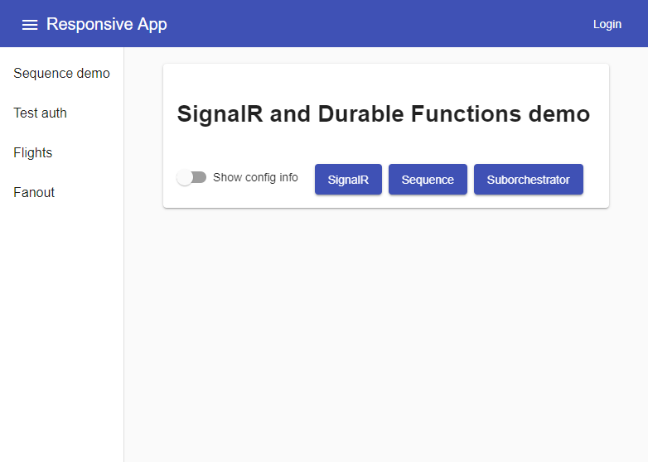
Why use Postman if you can build out a complete Angular SPA?
Azure Active Directory Authentication
WebSockets with Azure SignalR Service
Angular
Google Material Design
Azure Storage Static Website GA December 2018
https://github.com/cveld/durableFunctionsExample
*) Go see this afternoon’s session about securing Azure Functions With Azure Active Directory by Rick van den Bosch at 14:50
*)

Slide 21
Demo 2: Cancellable workflow
Suborchestrator
External event handling
WebSockets (SignalR)
S1
S2
S3
Suborchestrator
Activity
SignalR

Slide 22
Intermezzo: Orchestrator Constraints
Orchestrator code must be deterministic
Never use random numbers, DateTime.UtcNow, Guid.NewGuid(), etc.
Use DurableOrchestrationContext.CurrentUtcDateTime
Never do I/O directly in the orchestrator
Do I/O in activity functions
Don’t write infinite loops
Use DurableOrchestrationContext.ContinueAsNew()

Slide 23
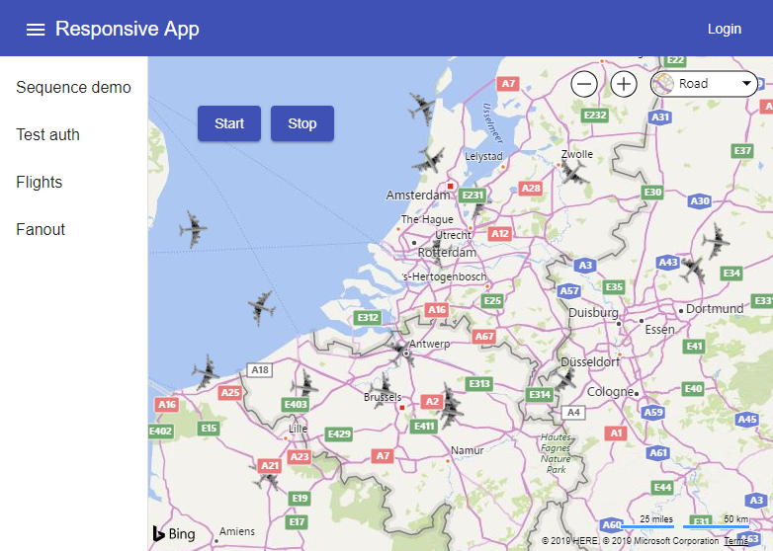

Demo: flight data api monitoring
Looping
Time management

Slide 24
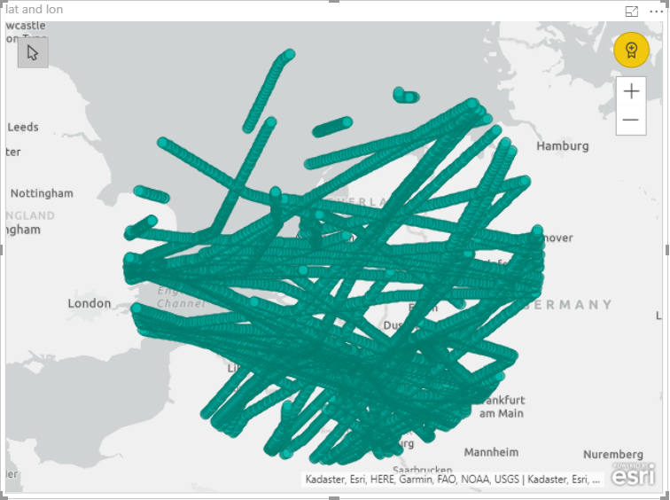



Intermezzo: Big Data flights stub data
https://opensky-network.org/
Power BI
Future Tech – 13 March 2019 – Introduction to Azure Durable Functions – Carl in ’t Veld – @cveld

Slide 25
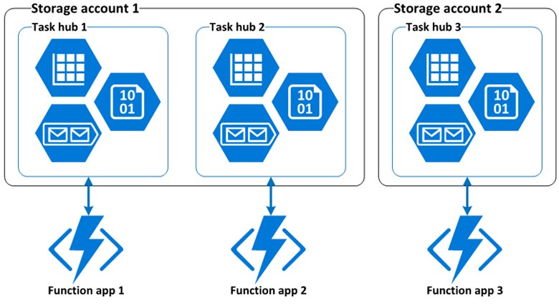
Task hub
A task hub consists of the following Azure storage resources:
One or more control queues;
One work-item queue;
One history table;
One instances table;
One storage container containing one or more lease blobs.

Slide 26
Durable functions utilize Azure storage through a Task hub
A function app containing multiple (durable) functions integrates with exactly one Task hub
A task hub utilizes Azure Storage
Do plan your data life-cycle
Redis Cache as a back-end is being planned

Slide 27
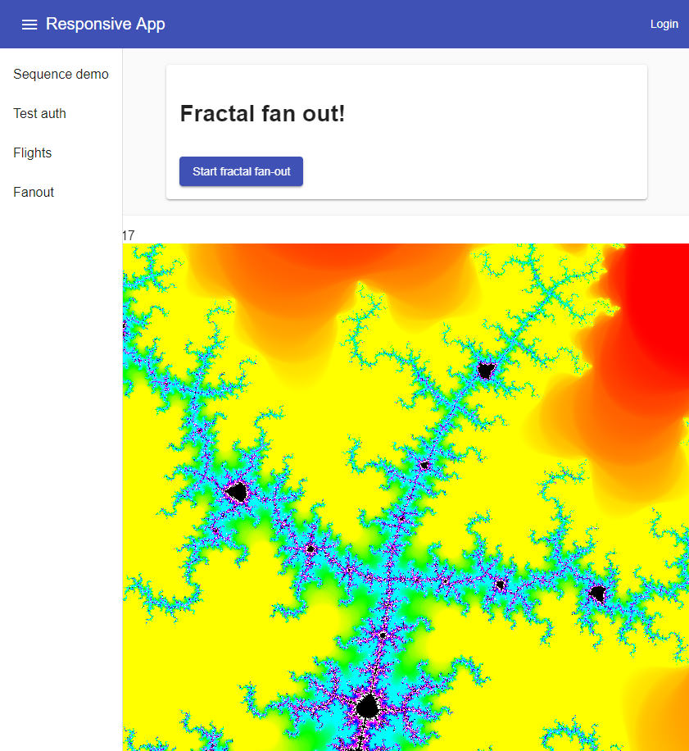
Demo: Fractal fan-out fan-in
Cloud-scale parallel execution
Blob storage
F1
F3
F2

Slide 28
Azure Functions Hosting Options
Consumption
Rapid scale out
”Unbounded” scale out
No VNet connectivity available
10 minute execution
Small instance size
Scale to zero (cold start)
App Service Plan / Environment
Auto-scale out (~5 min)
Fixed scale out
VNet connectivity / hybrid
Unlimited execution duration
Premium instance size
Always on

Slide 29
Azure Functions Hosting Options
PRIVATE PREVIEW
Consumption
Rapid scale out
”Unbounded” scale out
No VNet connectivity available
10 minute execution
Small instance size
Scale to zero (cold start)
Functions premium plan
Rapid scale out
“Unbounded” scale out
VNet connectivity / hybrid
Unlimited execution duration
Premium instance size
Always on

Slide 30

Durable Functions vs Logic Apps
Both allow implementing advanced workflow patterns.
C#, F# and JavaScript | Visual Designer
~20 Bindings | 200+ Connectors
Portable runtime | Runs only on Azure
Monitoring based on App Insights and APIs | Rich monitoring and management tools
Serverless, dedicated and isolated | Serverless only
Stateful Replays | Queued Dependency Graph
Notes:
At the end of the day, both durable functions and logic apps have their benefits. From speaking with several customers, we’ve realized that which one you choose is simply a matter of individual preference.
Logic Apps is a big product itself with several features of its own so I wont dive into too much detail about that here but feel free to stop by our booth to see some demoes and get more information.
Logic Apps can run Durable Functions! You can hook them into your Logic Apps workflows.

Slide 31
Thanks!
Special thanks to:
Lucas Caljé
Frank Noorloos
References:
https://docs.microsoft.com/azure/azure-functions/durable/durable-functions-overview
Jeff Hollan @ .NET Conf 2018 https://channel9.msdn.com/Events/dotnetConf/2018/S204
https://github.com/cveld/durableFunctionsExample

Slide 32
THE END

